Slide 1





Optimizing Beverage Sales:
Placing the Right Beverage in the Right Market
VEMURU VENISHA
23f2003668@ds.study.iitm.ac.in
IIT Madras - Data Science & Programming

Slide 2

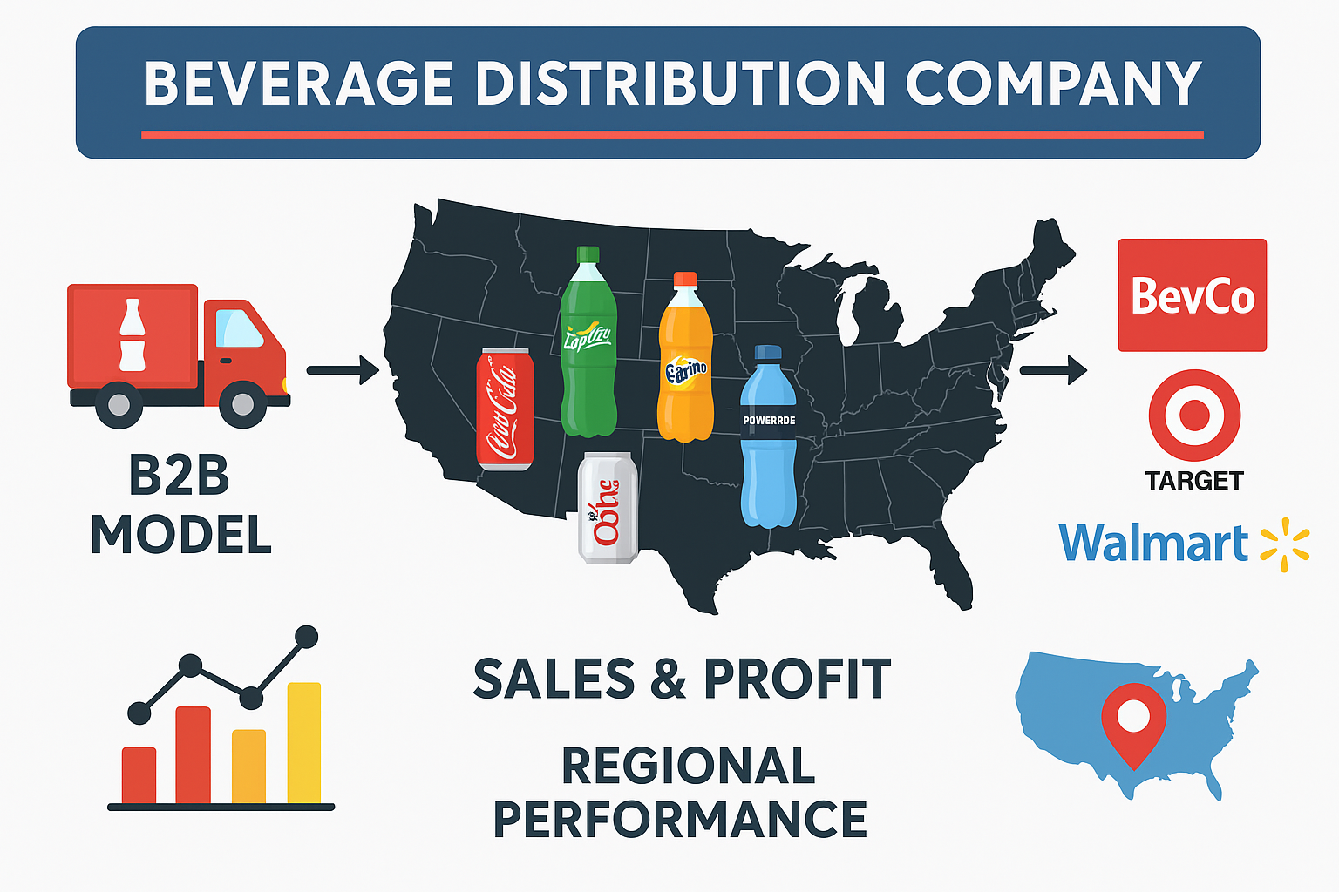
ABOUT THE BUSINESS
  A beverage distribution company operating across the United States under a B2B model.
  Supplies beverages like Coca Cola, Sprite, Fanta, Diet Coke, Powerade, and Dasani Water.
  Sells mainly to large retailers such as BevCo, Target, and Walmart.
  Operates across multiple U.S. regions with varying sales performance.Focuses on improving sales efficiency, marketing strategy, and profitability through data analysis.

Slide 3
Need of study
The company faced uneven sales and profit distribution across regions and products.
Uniform pricing and marketing were causing loss of revenue and excess stock.
There was a lack of data driven decision making in product placement and regional targeting.
The study helps to identify regional consumer preferences using real sales data.
Insights from the analysis aim to reduce wastage, improve profitability, and enhance customer satisfaction.

Slide 4
METHODOLOGY
Beverage sales data from 2022–2023 across multiple U.S. regions and retailers.
Dataset contained 9,647 records and 14 columns, including Retailer, Region, Beverage Brand, Price per Unit, Total Sales, and Profit.
Used Python (Pandas, Matplotlib, Seaborn) to analyze trends, compute descriptive statistics, and create visualizations.
Studied relationships between Price per Unit, Units Sold, Total Sales, Operating Profit, and Margin.
The Data Profiling Report is given in the following link: https://drive.google.com/file/d/1bv0Oe1HtiDihf66eGv5AhOi4aVtnWHYw/view?usp=sharing

Slide 5


CHALLENGES
Uniform Pricing and Promotions: Applying the same pricing and marketing strategy across all regions ignores local preferences, income levels, and culture.
Uneven Sales Across Regions: Some beverages like Coca-Cola sell very well in a few regions, while others show poor sales, leading to wastage and reduced profits.
Mismatch of Products with Market Needs: Popular drinks in one region may not sell well in another, requiring region-specific strategies.

Slide 6
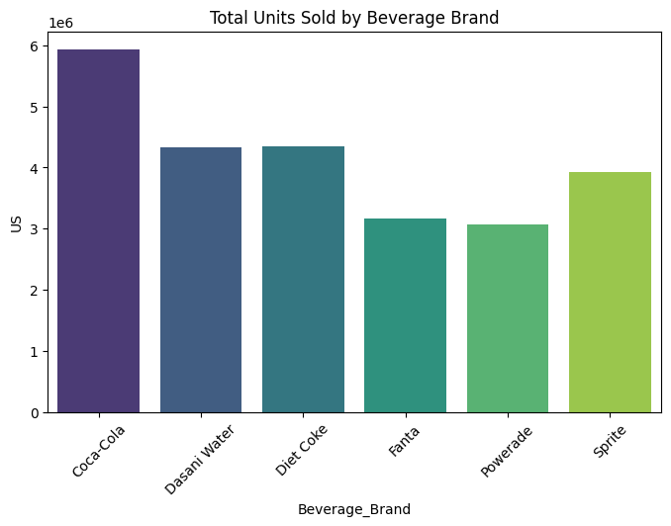
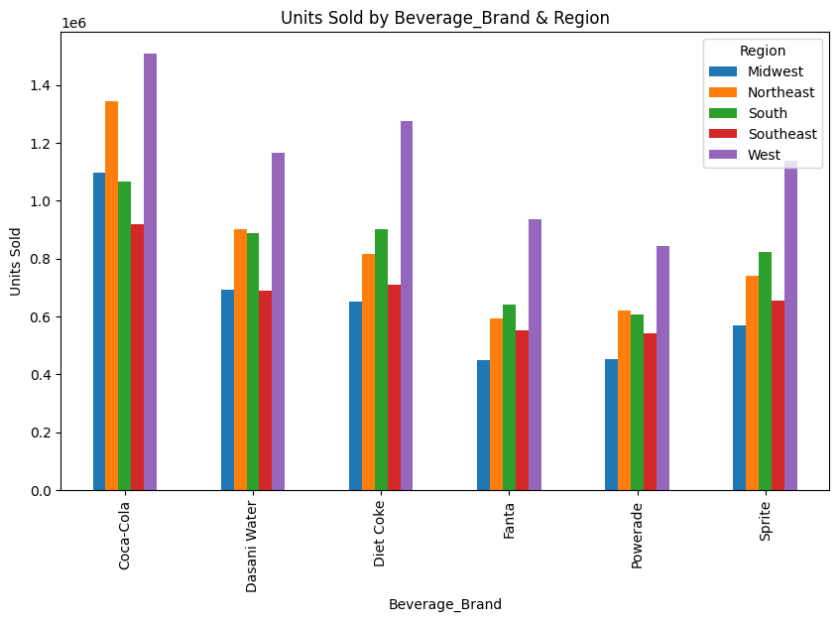
Uneven Sales Across Regions

Slide 7
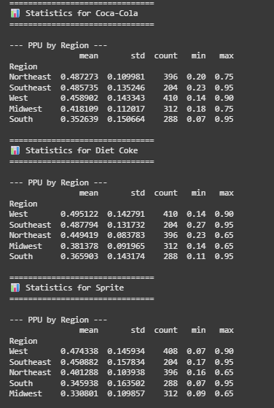
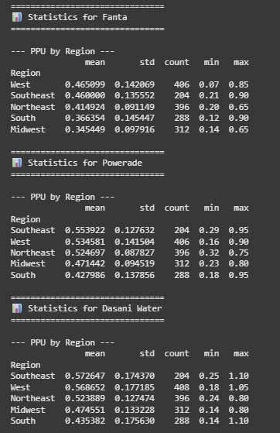
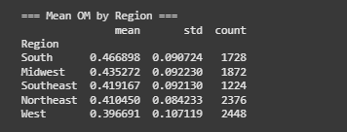
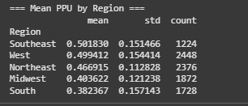
Uniform Pricing and Promotions

Slide 8
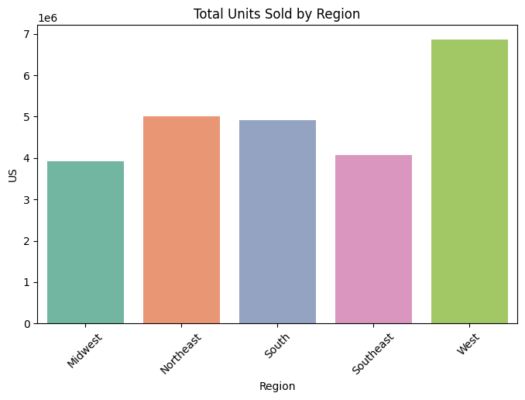
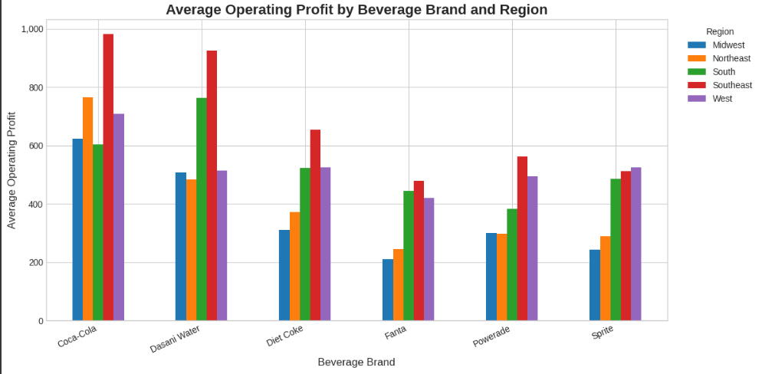
Mismatch of Products with Market Needs

Slide 9
FINDINGS
Coca-Cola recorded the highest sales and profit, while Fanta and Powerade performed the lowest.
FizzyCo achieved the highest Operating Margin (0.445), whereas Walmart had the lowest (0.409).
South region showed the highest average margin, while West recorded the lowest sales performance.
Games-Howell test confirmed significant differences in profitability across brands, regions, and retailers, proving uneven market behavior.
Correlation results: Units Sold, Price per Unit, and Total Sales are inversely proportional to Operating Margin, but directly proportional to Operating Profit.

Slide 10
RECOMMENDATIONS
Decrease price per unit slightly to improve profit and operating margin.
Apply region-based pricing and promotions instead of uniform strategies.
Focus on Southeast region using local offers and targeted marketing.
Improve Walmart’s performance by optimizing pricing and margin strategy.
Strengthen Midwest and Southeast regions with better promotion and distribution.
Promote Fanta and Powerade through advertising to boost moderate sales.
Customize retailer specific strategies for BevCo, Target, and Walmart.

